Slide 1
Introduction to Graphics
Text Graphics

Slide 2
Pygame
Pygame is a library to provide tools to help develop graphical programs and simple games
Pygame can be very powerful with the proper knowledge, but requires lots of patience and trial and error

Slide 3

Getting Started
All your programs that use Pygame will have the following code:

Slide 4
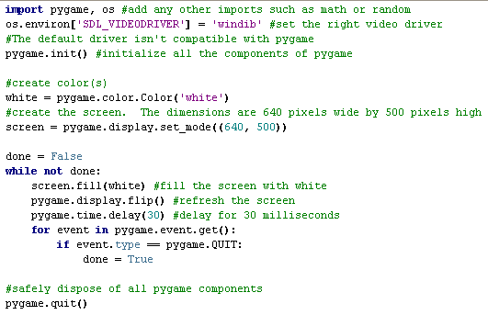
Creating a screen

Slide 5
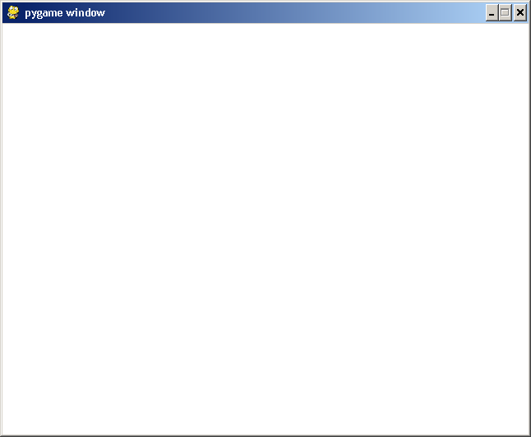
Creating a Screen Output

Slide 6
Pygame Colors
We’ve seen that Pygame has the color white and is created by the line:
white = pygame.color.Color(‘white’)
Pygame supports the following other colors:
black, red, green, blue, yellow, cyan, magenta, purple, brown, orange, pink, turquoise, gray, white (and loads of others)

Slide 7
Pygame Colors
Pygame allows you to create your own custom colors!
Syntax:
  color_name = pygame.color.Color(r,g,b)
  r = amount of red (0-255)
  g = amount of green (0-255)
  b = amount of blue (0-255)
E.g. create a chocolate brown:
chocbrwn = pygame.color.Color(210, 105, 30)

Slide 8
The Screen
screen = pygame.display.set_mode( (640,500) )
screen is a reference to the current display screen.
All drawings you make will be applied to this particular screen
screen is 640 pixels wide by 500 pixels high
The top-left corner of the screen has coordinates (0,0)
  The bottom-right corner of this screen has coordinates (639, 499) (one less than the width and height)

Slide 9
Top-left corner
(0,0)
width
Top-right corner
(width-1, 0)
height
Bottom-left corner
(0, height -1)

Slide 10
Drawing Text
In order to draw text, Pygame has to have some knowledge of how your text is supposed to look
Pygame uses fonts to determine how text should appear
Pygame supports many font names that already exist on the computer.
  If the font name doesn’t exist, a default font will be used
The following lines create a new font with of size 12:
font = pygame.font.SysFont(name=‘arial’, size=12, bold=False, italic=False)

Slide 11
Drawing Text
Once you have created your font, you can use it to make images of text.
The following makes an image of the phrase “Hello world!”
  black = pygame.color.Color('black')
  textimage = font.render('Hello world!', True, black)
textimage is an image version of the text.

Slide 12
Drawing Text
Finally, we ‘paste’ the image of the text onto the screen.
We use the blit() function to merge one image onto another.
  In the following case, we draw the image textimage onto our screen at location (300, 200) from the top-left corner
  screen.blit(textimage, (300,200) )

Slide 13
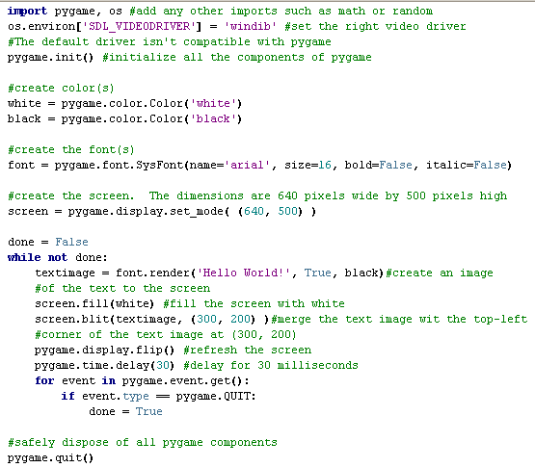
Putting it All together

Slide 14
